Slide 1
SQLintersection Session SQL37 SQL Server 2012 Availability Groups
Aaron Bertrand
abertrand@sqlsentry.net

Slide 2
Overview
Why were Availability Groups introduced?
What do they do?
How do they work?
What do they NOT do?
What enhancements will come in SQL Server 2014?

Slide 3
Why were Availability Groups introduced?
Many ways of achieving high availability and/or disaster recovery:
Database Mirroring
Log Shipping
Replication
Failover Cluster Instances
All have shortcomings
Availability Groups are, essentially, Mirroring++
More importantly, overcome most of the shortcomings
Notes:
Mirroring is single database, single partner, not available for read (use snapshots) – coordinating multiple databases to fail over together is difficult, and snapshots are a maintenance nightmare
(It’s also deprecated, with no clear replacement for Standard Edition. I sometimes wonder if Standard Edition will be deprecated soon.)
Log shipping is single database, multiple partners, only available for read between restores
Replication is more granular (table level), but let me know who here actually *likes* replication
Failover cluster instances are whole instance, only live on one node at a time (so can’t scale reads), and require shared storage – can’t protect from I/O failure

Slide 4
What do Availability Groups do?
Coordinate failover of multiple databases as a single unit
Provide for multiple replica partners (“secondaries”) – up to 4 (2 sync)
Reduce load on primary by allowing read-only workloads on secondaries
Reporting, log backups, full backups (well, COPY_ONLY)
Applications don’t have to know where their queries are routed
Teach you new buzzwords like RPO, RTO and RLO
Control over whether availability has (a)synchronous commit
Control over whether failover is automatic or manual
Control preference for where secondary replica backups occur
Many of same benefits as mirroring – log compression, auto page repair
Faster log synchronization than log shipping or replication
Flexible Failover Policies
Notes:
(Well, 5 if you include the primary)
No more single point of failure - No SAN required; each replica has its own copy
RPO = recovery point objective = allowable data loss
RTO = recovery time objective = allowable downtime
RLO = Recovery level objective – usually the database, but could be object level (replication) or instance (clustering)

Slide 5
How do Availability Groups work?
Availability Groups use Windows Server Failover Clustering (WSFC)
Failover Clustered Instances (FCI) are possible, but not necessary
Same domain is required, but a WSFC can cross subnets
Shared storage not required
Quorum is used to determine whether enough nodes are up
Health Detection uses various metrics to determine state
Can fail over automatically or manually; automatic can be tuned
Synchronous / asynchronous commit trade availability for performance
Automatic failover requires synchronous commit
Listener is used to route connections, vs. transparent client redirect
Depending on availability and application intent
Can load balance reads across secondaries, and offload after failover
Notes:
In fact, FCIs actually introduce some configuration limitations, for example they negate automatic failover and they restrict which nodes in the WSFC can be used for the AG
Read only access: http://www.bidn.com/blogs/PatrickLeBlanc/ssis/2513/alwayson-configuring-secondary-read-only-access

Slide 6
Flexible Failover Policy
Failure Condition | Level
On server down. This is the least restrictive level. | 1
On server unresponsive. | 2
On critical server error (1 and 2, plus internal errors). DEFAULT | 3
On moderate server error. (1 – 3, plus other errors like stack dumps). | 4
On any qualified failure conditions. (1 – 4, plus other errors like worker thread exhaustion and unresolvable deadlocks). | 5
Notes:
Mirroring = 10 second timeout, FCI = 5 missed hearbeats by default
Failure Condition
Level
On server down. Specifies that an automatic failover is initiated when any of the following occurs:
The SQL Server service is down.
The lease of the availability group for connecting to the WSFC cluster expires because no ACK is received from the server instance. For more information, seeHow It Works: SQL Server AlwaysOn Lease Timeout.
This is the least restrictive level.
1
On server unresponsive. Specifies that an automatic failover is initiated when any of the following occurs:
The instance of SQL Server does not connect to cluster, and the user-specified health check timeout threshold of the availability group is exceeded.
The availability replica is in failed state.
2
On critical server error. Specifies that an automatic failover is initiated on critical SQL Server internal errors, such as orphaned spinlocks, serious write-access violations, or too much dumping.
This is the default level.
3
On moderate server error. Specifies that an automatic failover is initiated on moderate SQL Server internal errors, such as a persistent out-of-memory condition in the SQL Server internal resource pool.
4
On any qualified failure conditions. Specifies that an automatic failover is initiated on any qualified failure conditions, including:
Exhaustion of SQL Engine worker-threads.
Detection of an unsolvable deadlock.
This is the most restrictive level.
5

Slide 7
Asynchronous vs. Synchronous Commit
Synchronous commit waits for log to be hardened on secondary
This eliminates data loss potential, at the cost of performance
Usually combined with automatic failover with “close” replica(s)
Asynchronous commit does not wait for log to harden
This improves performance, but introduces risk of data loss
Only supports manual failover, and should be the only option for remote / DR replicas

Slide 8
Quorum
Quorum means enough “votes” to keep the resource up
To ensure health and to prevent “split brain”
You want an odd number of quorum votes : up = “more than half”
If even number of nodes, use disk (shared) or file share (non shared)
Node majority (for odd number of nodes)
Node and file share majority (for even number in asymmetric storage)
Node and disk majority (for even number in shared storage)
Disk only (for shared storage)
You may want certain nodes to not have a vote (NodeWeight). E.g.:
Nodes on another subnet on a less reliable network
Priority in a multi-group or multi-instance scenario
Notes:
Kendra calls it “taking attendance” – if more than half the students are present, class can continue
http://msdn.microsoft.com/en-us/library/hh270280.aspx
http://msdn.microsoft.com/en-us/library/hh270281.aspx
http://blogs.msdn.com/b/sqlalwayson/archive/2012/03/13/quorum-vote-configuration-check-in-alwayson-availability-group-wizards-andy-jing.aspx
http://technet.microsoft.com/en-us/library/cc730649(WS.10).aspx

Slide 9
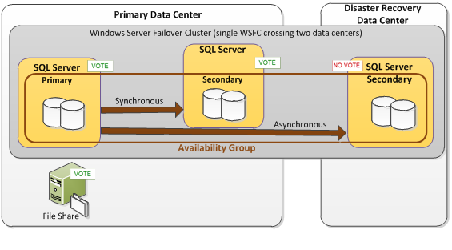
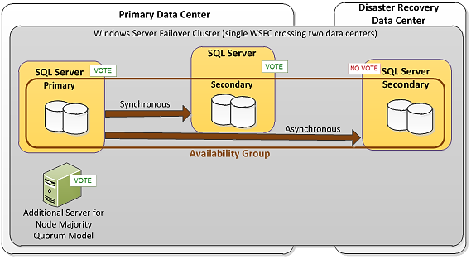
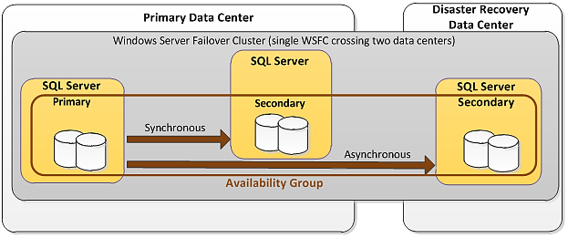
Quorum Example
Notes:
First image = basic AG for high availability and disaster recovery
Second image = Node and File Share Majority quorum model
Third image = Node Majority quorum model
~~~
So why do AG’s use a WSFC?
Two things: Listener and Quorum
Listener abstracts the behind the scenes server/instance change just like an FCI:
Has a clustered network name & IP address just like an FCI. Plan carefully, you might need a lot of them and they must be unique.
Creates an object in AD (VCO) and DNS
Applications can connect to Listener
Quorum differs a lot from DBM, using the WSFC mechanism

Slide 10
Common Questions
How do I migrate from database mirroring?
http://blogs.msdn.com/b/sqlalwayson/archive/2012/10/16/how-to-migrate-to-alwayson-alwayson-from-prior-deployments-combining-database-mirroring-and-log-shipping-part-1.aspx
http://msdn.microsoft.com/en-us/library/jj635217.aspx
What is involved in forcing a manual failover?
http://technet.microsoft.com/en-us/library/ff877957.aspx
How do I monitor Availability Groups?
DMVs, SSMS (dashboard/Object Explorer Details), Extended Events
We’ll talk a bit about our software during this afternoon’s keynote
http://technet.microsoft.com/en-us/library/ff877954.aspx

Slide 11
What do Availability Groups NOT do?
Handle cross-database transactions – consistency is not guaranteed
Commits are db-specific, so failover can cause out of sync
Distributed transactions cause an additional wrinkle after failover
Coordinate logins, jobs, linked servers, dbowner, trustworthy
Allow delayed apply, like log shipping
Go across domains – all WSFC nodes must be in the same domain
Wizard is inflexible – can’t specify WITH MOVE, for example
Run on Standard Edition, without a WSFC, or anything but full recovery
Save you money (active secondaries must be licensed)
Keep read-only secondaries available if primary is down
Solve every single HA/DR problem – e.g. suspect/damaged database
Notes:
https://connect.microsoft.com/SQLServer/feedback/details/723879/sql-2012-always-on-availability-group-change-or-alter-db-owner-does-not-replicate-to-secondary

Slide 12
SQL Server 2014 Enhancements
Now up to 8 secondary replicas (still 2 sync + automatic)
Readable secondaries stay available if network or quorum is down
Enhanced diagnostics
More specific error messages
XEvents in UTC time
More XEvents
Integration with Windows Azure (IaaS)
Can have sync + automatic failover replica inside Windows Azure
Can have async secondary replica for on-premise (requires VPN tunnel)
Notes:
http://blogs.technet.com/b/dataplatforminsider/archive/2013/06/27/alwayson-in-sql-server-2014-ctp1.aspx

Slide 13
Additional Resources
Twitter and #SQLHelp
http://SQLCAT.com
http://SQLSkills.com
Community Sites:
http://SQLPASS.org
http://SQLServerCentral.com
http://SQLBlog.com
http://SQLTeam.com
http://SQLPerformance.com
http://dba.stackexchange.com
Brent Ozar Availability Groups Checklist http://i.brentozar.com/sql-server-2012-alwayson-availability-groups-setup-checklist.pdf
AG Troubleshooting and Monitoring Guidehttp://blogs.msdn.com/b/sqlalwayson/archive/2013/06/06/alwayson-availability-groups-troubleshooting-and-monitoring-guide-published.aspx

Slide 14
Final Comments
Availability Groups are one of the most compelling reasons to upgrade
We talked about:
Why were Availability Groups were introduced
What Availability Groups do
How Availability Groups work
What Availability Groups don’t do
What enhancements will come in SQL Server 2014
More info: come see the keynote this afternoon
Questions?
abertrand@sqlsentry.net
Notes:
Great introductory checklist here: http://i.brentozar.com/sql-server-2012-alwayson-availability-groups-setup-checklist.pdf
And lots of additional resources here: http://www.brentozar.com/sql/sql-server-alwayson-availability-groups/

Slide 15
Questions?
Don’t forget to complete a session evaluation form and drop it off at the conference registration desk
(or use the mobile app)
Session: SQL37
Thank you!

