Slide 1
What’s New in SQL Server 2014: Database Engine
Aaron Bertrand
SQL Sentry
abertrand@sqlsentry.com

Slide 2
About Me
Aaron Bertrand Senior Consultant @AaronBertrand
Microsoft MVP since 1997
Author, MVP Deep Dives 1 & 2
http://sqlblog.com/
http://sqlperformance.com/
abertrand@sqlsentry.com
http://sqlsentry.com/

Slide 3
Agenda
Scalability Enhancements
Compatibility Level Changes
Backup / Restore Enhancements
Cloud Enhancements
Performance Enhancements
Availability Group Enhancements
T-SQL Enhancements
Security Enhancements

Slide 4
Scalability Enhancements
640 processors, 4 TB memory
(Virtual = 64 processors, 1 TB)
Standard Edition now supports 128 GB RAM per instance
2008 = system max, 2012 = 64 GB

Slide 5
Compatibility Level Changes
Compatibility Level of 90 is now “retired”
Can still attach 2005/90 databases, but they get upgraded to 100
This is different from 2012, which did not support 2000/80 at all

Slide 6
Backup / Restore Enhancements
Backup to URL / Azure
Backup Encryption
Supported in Standard / BI / Enterprise

Slide 7
Cloud Enhancements
Host a data file as Windows Azure blob
Host a database in a Windows Azure Virtual Machine
Deploy a database to Windows Azure wizard

Slide 8
Performance Enhancements: In-Memory OLTP
New index structure eliminates locking and latching
This Is *NOT* DBCC PINTABLE – it still needed to use latching
Optimistic MVCC – update = new row, modified B-tree = no page hotspot
Use natively compiled procedures for biggest benefit (no context switching)
Can also create in-memory TVPs and table variables
Sweet spot: Highly concurrent workloads with small transactions
Down-sides:
Some data types not supported
No parallelism
Plenty of functionality not covered in natively compiled procedures
256 GB limit on table size
Only supported in Enterprise Edition
Not all bottlenecks are solved!
Notes:
http://blogs.technet.com/b/dataplatforminsider/archive/2012/11/08/breakthrough-performance-with-in-memory-technologies.aspx
http://blogs.technet.com/b/dataplatforminsider/archive/2013/07/22/architectural-overview-of-sql-server-2014-s-in-memory-oltp-technology.aspx
All kinds of diagnostics / metadata changes:
http://msdn.microsoft.com/en-us/library/dn133080(v=sql.120).aspx

Slide 9
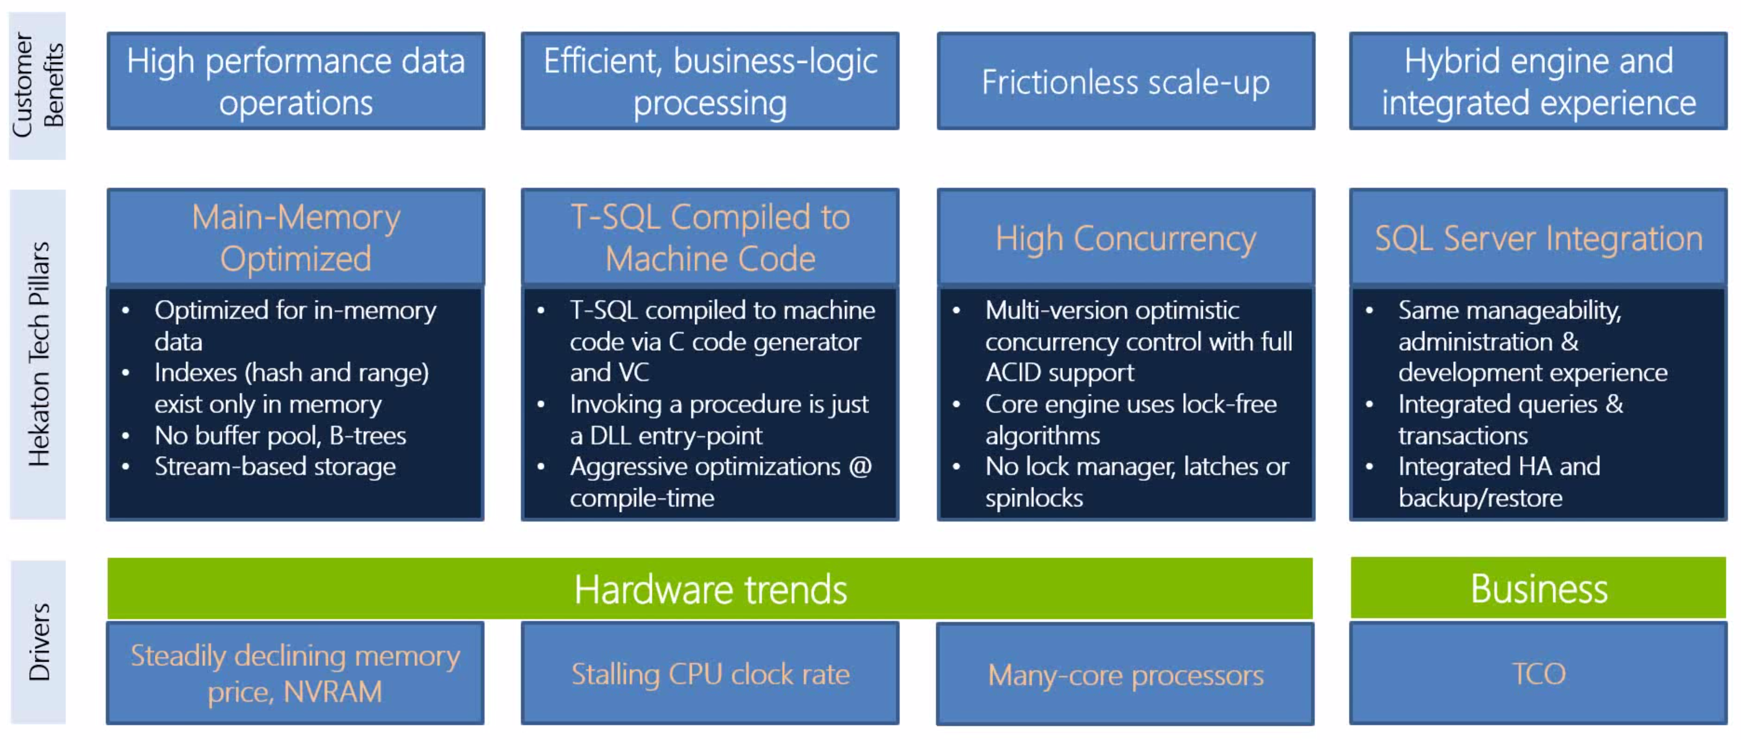

Slide 10
Performance Enhancements: Columnstore Indexes
Updatable, clustered Columnstore now supported
New COLUMNSTORE_ARCHIVE compression
Better compression at higher CPU cost – 80-90% compression
Far fewer data type restrictions than 2012
More operators support batch mode processing
Sweet spot: Real-time analytics involving large scans and aggregations
Niko Neugebauer has a thorough 28-part blog series:
http://bit.ly/Niko-ColumnStore
Notes:
http://www.nikoport.com/2013/07/05/clustered-columnstore-indexes-part-1-intro/

Slide 12
Performance Enhancements: Buffer Pool Extension
Extend buffer pool to SSDs
Only puts “clean” evicted pages there; no durability risk
Sweet spot: OLTP databases larger than available memory
(Not for large scans etc.)
Only supported in Standard and Enterprise (not BI, according to BOL)
You *can* put it on spinny disks, but please don’t
Notes:
http://www.sqlperformance.com/2013/12/t-sql-queries/a-first-look-at-the-new-sql-server-cardinality-estimator

Slide 13
Performance Enhancements: Delayed Durability
Proceed after commit, but before t-log acknowledge
Sweet spot: Particularly helpful on servers with slow log disks
Caveat:
Need to have ~64K data loss tolerance

Slide 14
Performance Enhancements: Cardinality Estimator
Great enhancements in estimates
It can make a lot of bad queries better
There can still be regressions, but these should be uncommon
Can turn it on/off for a database with compatibility level
Can turn it on/off at the query level with QUERYTRACEON 2312 / 9481
Notes:
http://www.sqlperformance.com/2013/12/t-sql-queries/a-first-look-at-the-new-sql-server-cardinality-estimator
http://www.brentozar.com/archive/2014/04/sql-2014-cardinality-estimator-eats-bad-tsql-breakfast/

Slide 15
Performance Enhancements: Resource Governor
Now governs I/O
MIN_IOPS_PER_VOLUME and MAX_IOPS_PER_VOLUME per resource pool
MAX_OUTSTANDING_IO_PER_VOLUME at instance level
Latter wins
Important to note:
These settings do not specify I/O size or throughput
Still Enterprise Edition only

Slide 16
Performance Enhancements: Miscellaneous
Tempdb will now defer / bypass flushing to disk of some bulk operations
SELECT INTO #temp tables, SORT_IN_TEMPDB index maintenance
This fix may be back-ported to SQL Server 2012 SP2
Can now rebuild individual partitions
Incremental statistics – per partition
Can set low priority lock waits for rebuild / switch operations
More online operations
SELECT INTO can now run in parallel
Compatibility level must be 110+
sys.dm_exec_query_profiles
Monitor a query plan in real time
Notes:
http://blogs.msdn.com/b/psssql/archive/2014/04/09/sql-server-2014-tempdb-hidden-performance-gem.aspx
http://www.sqlperformance.com/2013/09/sql-indexes/partition-index-ops-sql2014
http://www.sqlperformance.com/2014/02/sql-statistics/2014-incremental-statistics
http://www.sqlperformance.com/2013/09/sql-indexes/lock-priority-sql2014
http://www.sqlperformance.com/2013/08/t-sql-queries/parallel-select-into

Slide 17
Availability Group Enhancements
Add Azure Replica wizard
Secondary replicas now 8 instead of 4
Secondaries now remain read-available during primary/quorum outage
Supposed to be back-ported to 2012 as well, likely in SP2
FCIs can now use cluster shared volumes (CSVs)
Many new DMVs, functions, extended events for diagnostics
Still no word about a replacement for mirroring in Standard Edition

Slide 18
T-SQL Enhancements
Can now include *simple* index def within CREATE/DECLARE TABLE
But not if index is filtered or has INCLUDE columns
CREATE TYPE dbo.foo AS TABLE
(
bar INT, INDEX x NONCLUSTERED(bar DESC)
);
Syntax to support In-Memory OLTP
mostly DDL changes
Notes:
http://msdn.microsoft.com/en-us/library/dn133180(v=sql.120).aspx

Slide 19
Security Enhancements
New server-level permissions:
CONNECT ANY DATABASE
IMPERSONATE ANY LOGIN
SELECT ALL USER SECURABLES
New database-level permission:
ALTER ANY DATABASE EVENT SESSION

Slide 20
Other SQL Server 2014 Sessions
Jonathan Kehayias - Today at noon in this room Enterprise Availability and Performance on Commodity Hardware with SQL 2014 Today at noon in this room
Steve Jones - Today at 2:15 in this room Protecting Your Data with Encryption While Maintaining Performance in SQL 2014
Tim Chapman - Today at 3:45 in this room SQL Server 2012 & 2014 Enhancements for Developers
Mike Zwilling - Tomorrow at 11:45 in Palazzo E SQL Server 2014 : Columnstore Architecture and Capabilities
Richard Campbell - Tomorrow at 2:15 in Palazzo E Microsoft Q&A : Hidden Gems in SQL Server 2014
Three Microsoft sessions on In-Memory OLTP, all day Wednesday in this room
On-demand webinars: http://www.sqlpass.org/ss2014launch/Webinars.aspx

